Slide 1
American Women
In World War II
NATIONAL GRANGE OF THE ORDER OF PATRONS OF HUSBANDRY

Slide 2
Women in the War Effort
Over 400,000 women served in the military and/or wore the uniform.
Jobs included: nursing, armed services aviators, “Government Girls”, Red Cross, USO, scientists, health care, production, manufacturing, munitions, shipyards, factories, farming, and civil defense just to name a few.
From 1940 to 1945, women accounted for 19 million, or more than a third, of the American civil labor force.
Many woman wore uniforms in civilian employment as members of volunteer organizations and jobs with the government.
Women in the Military
NATIONAL GRANGE OF THE ORDER OF PATRONS OF HUSBANDRY

Slide 3
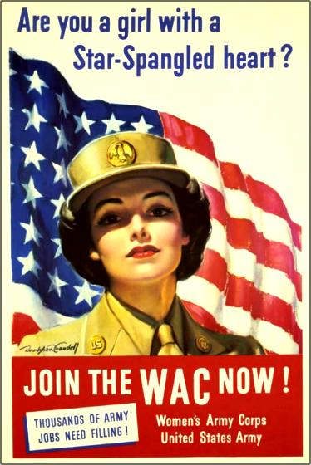
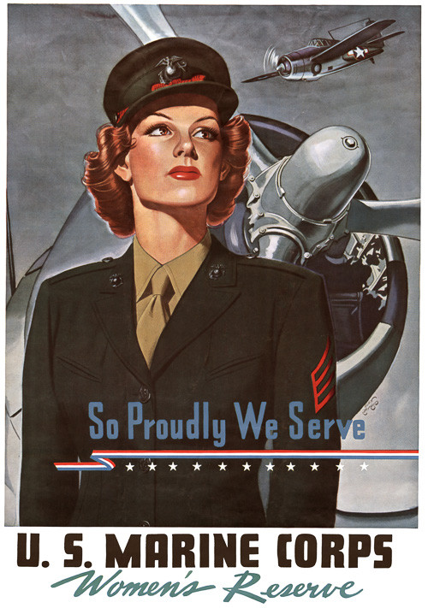
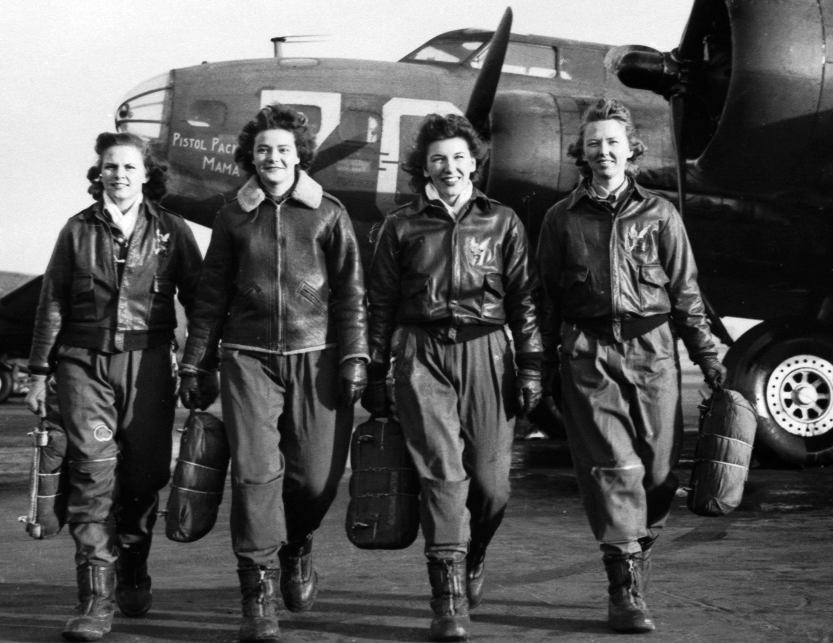
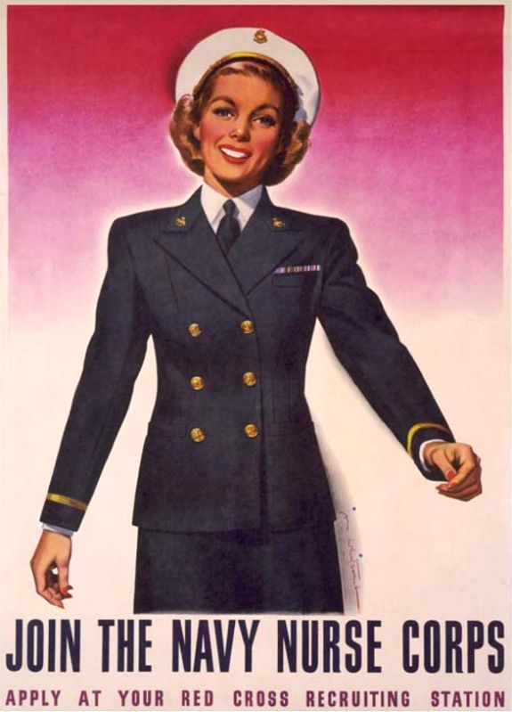
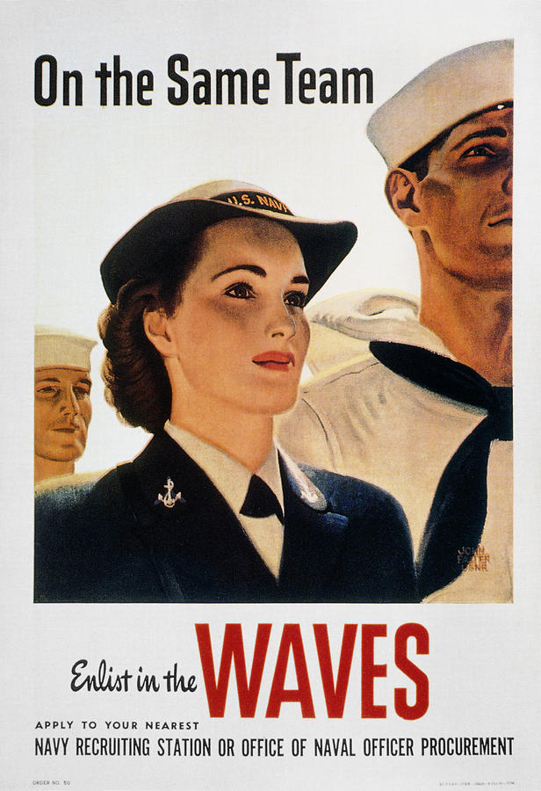
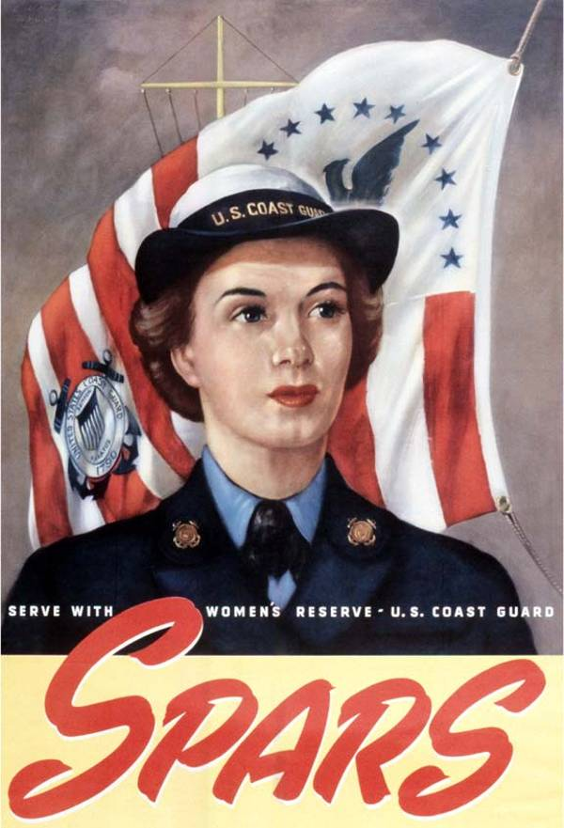
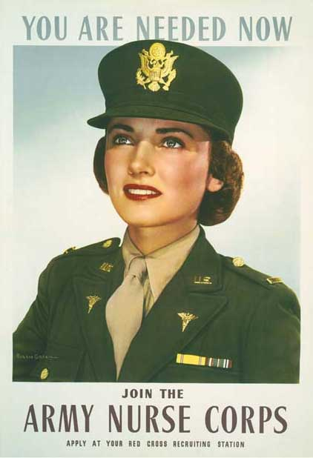
Women in the Military
Women served in many different auxiliary military forces during WWII. Included are the:
Navy Women’s Reserve
Coast Guard Women’s Reserve
Army Nurses Corps
Women’s Army Corp
Marine Corps Women’s Reserve
Women Service Pilots
Navy Nurses Corps
NATIONAL GRANGE OF THE ORDER OF PATRONS OF HUSBANDRY
Navy Women’s Reserve
Navy Women’s Reserve
Navy Women’s Reserve

Slide 4
Women in the Military
Established in 1901 and 1908 respectively, the Army and Navy Nurse Corps jumped into action during the bombing of Pearl Harbor.
At the time of the bombing, the military included 8,000 nurses. By the end of the War, the amount of Army nurses grew to 59,000 and the Navy nurses had grown to 11,000.
Members of the Nurse Corps served not only in the U.S., but wherever American soldiers were. Nurses were stationed in Normandy on D-plus-4.
NATIONAL GRANGE OF THE ORDER OF PATRONS OF HUSBANDRY

Slide 5
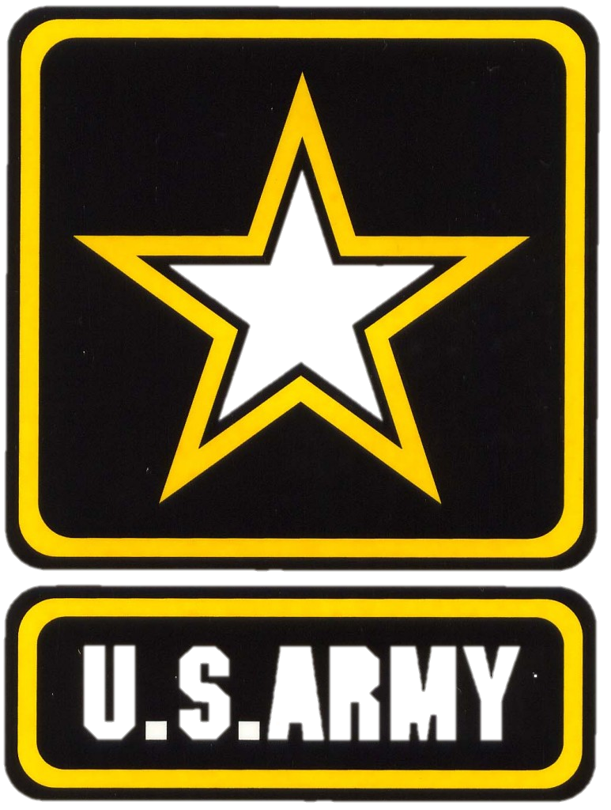
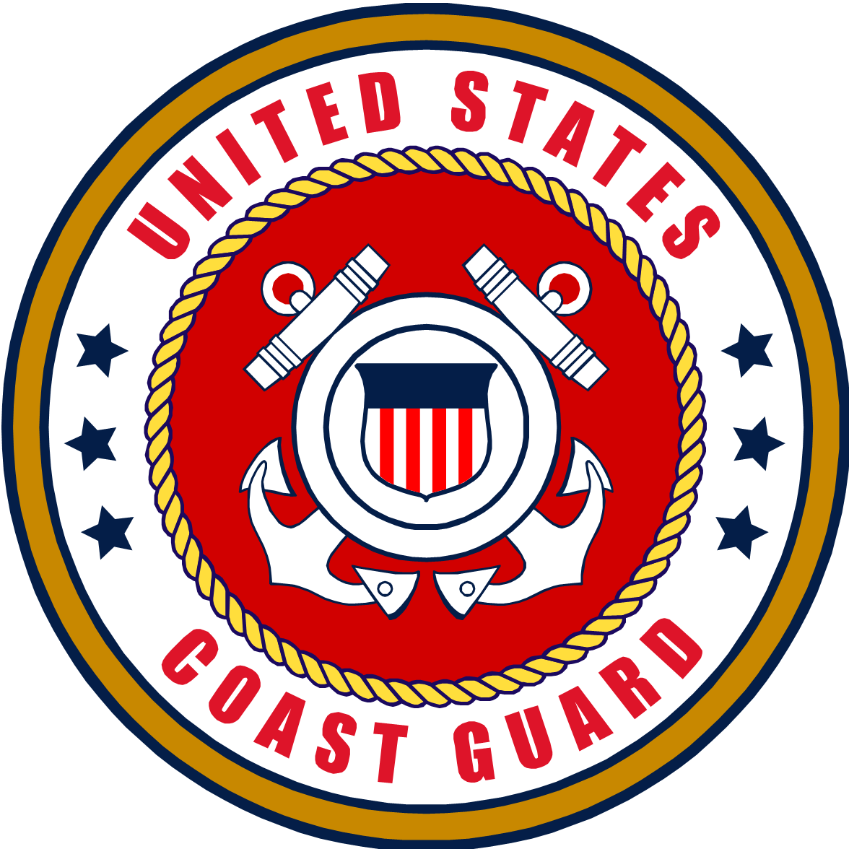
Congress authorized women to serve with the US Army, Navy and Coast Guard in 1942 and the Marines in 1943 for the duration of the “emergency” plus six months.
The Army Nurse Corps served on the frontlines and 16 were killed at the front. Another 400 American women died serving in the military. 88 American service women were captured as POWs.
Servicewomen filled administrative and clerical jobs to begin with but as more men were shipped out, women began replacing them, in what most had considered unsuitable for women for WWII. These jobs include everything but direct combat, such as: part of the motor pool, radio operators and repairmen, gunnery instructors, mechanics, flight instructs, and other advanced technical and scientific fields.
NATIONAL GRANGE OF THE ORDER OF PATRONS OF HUSBANDRY

Slide 6
In 1942, under Nancy Harkness Love, the Women’s Auxiliary Ferrying Squadron (WAFS) began flying aircraft from where they were manufactured to bases in need. Also, they were considered civilian employees that were contracted for 3 months at a time.
NATIONAL GRANGE OF THE ORDER OF PATRONS OF HUSBANDRY

Slide 7
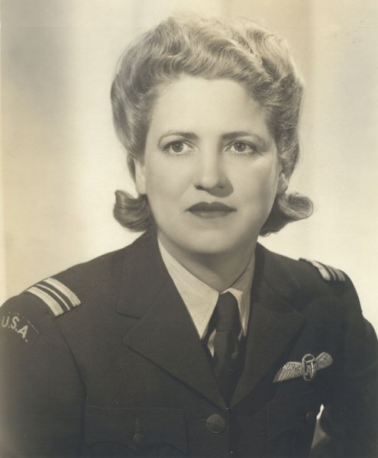
In 1942, Jacqueline Cochran founded the Women’s Flying Training Detachment (WFTD). The WFTD flew any service needed by the Army Air Corps.
In 1943, the WAFS and the WFTD merged to become Women’s Air Force Service Pilots (WASPs) . Jacqueline Cochran was chosen to lead the WASPs.
NATIONAL GRANGE OF THE ORDER OF PATRONS OF HUSBANDRY

Slide 8
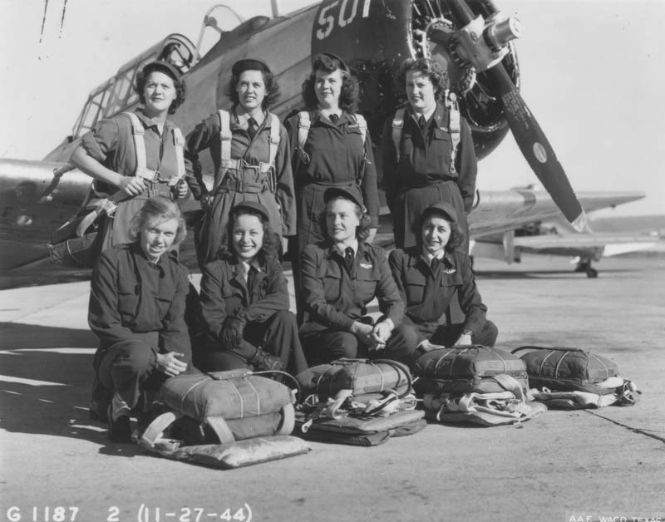
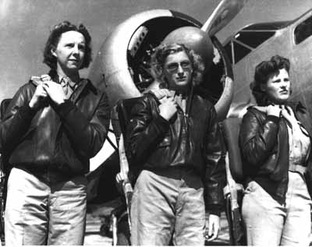
These women already had a pilot’s license prior to service. They then underwent more extensive training on military aircraft.
They ferried planes from factories to bases, transported cargo and participated in simulating missions.
They flew over 60 million miles on over 70 different kinds of aircraft.
Over 25,000 women applied but only 1,830 were accepted for these crucial and dangerous missions.
38 of them died while in service.
NATIONAL GRANGE OF THE ORDER OF PATRONS OF HUSBANDRY

Slide 9
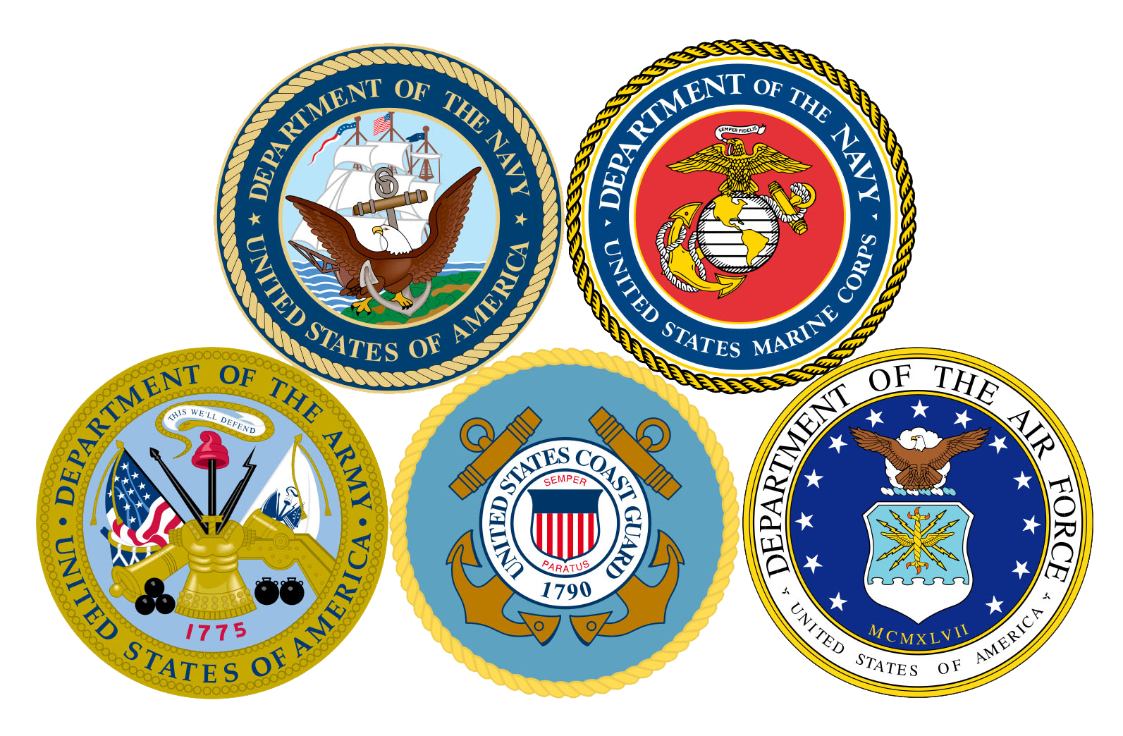
WASPs were NOT considered part of the military and were left without military status. They were considered civilians and had to pay for room and board at military facilities and were not allowed military honors or benefits.
In 1972, Congress recognized the WASPs full military status.
NATIONAL GRANGE OF THE ORDER OF PATRONS OF HUSBANDRY

Slide 10
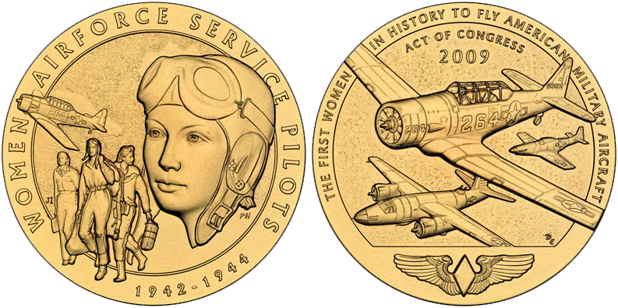
In 2010, WASPs received the Congressional Gold Medal, one of the highest civilian honors; more than 200 former pilots attended the event wearing their uniforms.
(Click box to play)
NATIONAL GRANGE OF THE ORDER OF PATRONS OF HUSBANDRY
Notes:
When playing video, clicking elsewhere causes video to end. Duration of video is 4 minutes and 5 seconds.

Slide 11
Government Girls
NATIONAL GRANGE OF THE ORDER OF PATRONS OF HUSBANDRY

Slide 12
Government Girls
Who were Government Girls?
What did Government Girls do?
Women who worked in the government but could only hold their jobs for the duration of the national emergency.
Their jobs were considered temporary until the men came back from the Front to reclaim their jobs.
These women typically were clerical workers in the War Department in Washington, DC. Others worked throughout all levels of the government across the country. Also these women were usually young and single.
Some women served in positions of intelligence gathering and analysis. To this day, most of these women will not speak about these classified jobs.
NATIONAL GRANGE OF THE ORDER OF PATRONS OF HUSBANDRY

Slide 13
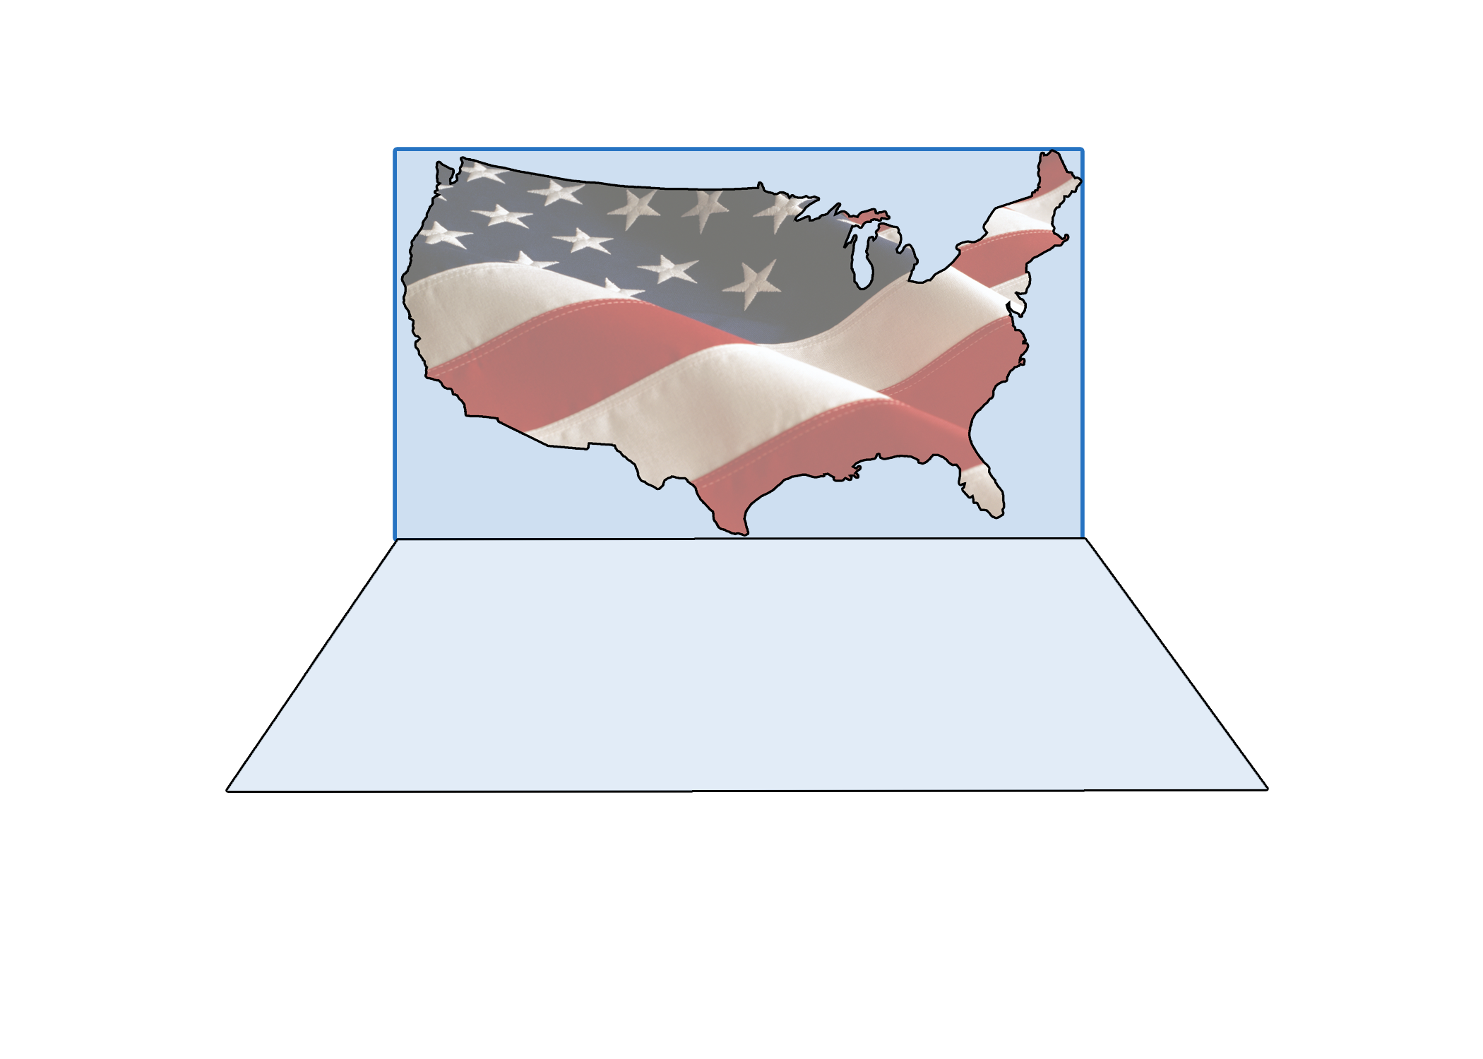
100,000
Nearly
women across the country worked as unpaid assistants to local rationing boards.
By 1944, women accounted for more than a THIRD of the civil service jobs.
NATIONAL GRANGE OF THE ORDER OF PATRONS OF HUSBANDRY

Slide 14
NATIONAL GRANGE OF THE ORDER OF PATRONS OF HUSBANDRY

Slide 15
The Red Cross worked closely with the military during WWII. The Red Cross had 40,000 employees at the time and directed more than 7.5 MILLION civilian volunteers serving the Armed Forces.
Over 200,000 of these women were enrolled in the Red Cross Nursing Service and they certified 71,000 nurses that served in the Army and Navy Nursing Corps.
They also made sure civilians at home were provided with critical health care.
The United Service Organizations (USO) was created in 1941 by six private groups: The YMCA, YWCA, National Catholic Community Service, the National Jewish Welfare Board, the Traveler’s Aid Association and the Salvation Army.
Women served as volunteers in over 3,000 locations in the States.
Overseas, the USO developed Canteens. They also put together packages of comfort items for the troops.
The USO is most famously recognized for USO Camp Shows, which still provide recreation for military personnel. The USO estimated putting on 428,521 shows during WWII.
NATIONAL GRANGE OF THE ORDER OF PATRONS OF HUSBANDRY

Slide 16
The Sharon Roger’s Band, all-female orchestra and USO Camp Shows unit played for military and civilian servicemen and women in the Pacific theater. They were only one of many professional entertainers who volunteered their time to perform for troops overseas.
During WWII, the Andrews Sisters, an American singing group comprised of LaVerne, Maxene and Patty Andrews, recorded a series of Victory Discs (V-Discs) for distribution to Allied fighting forces, as well as performing with the USO. They were dubbed the “Sweethearts of the Armed Forces Radio Service.”
(Click Icon to Play)
NATIONAL GRANGE OF THE ORDER OF PATRONS OF HUSBANDRY
Notes:
Audio duration is 2 minutes and 50 seconds. Clicking anywhere on the slide causes music to stop.

Slide 17
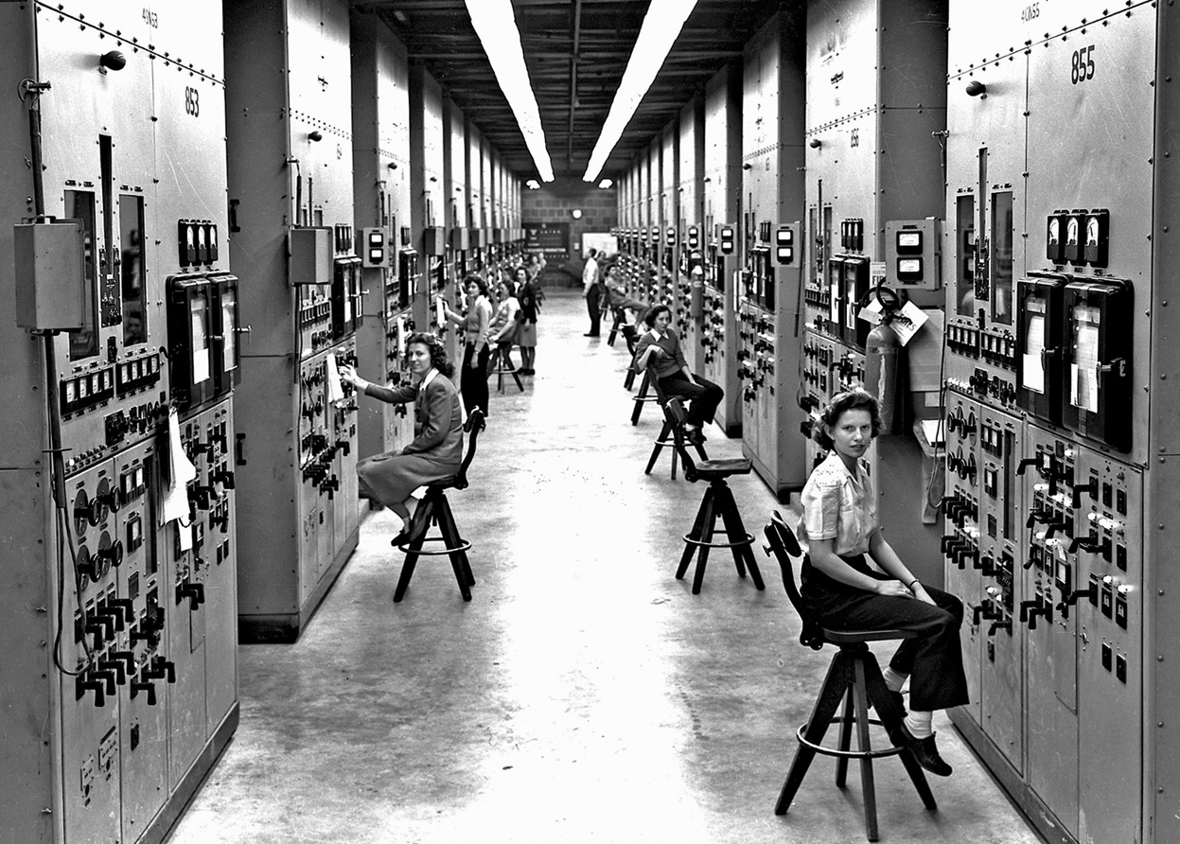
Women Researchers
Women participated in the role of researchers that began the nuclear age.
They also did laboratory testing that led to other scientific advances and inventions.
The War brought more prospects for women as chemists, researchers, engineers and technical assistants.
NATIONAL GRANGE OF THE ORDER OF PATRONS OF HUSBANDRY

Slide 18
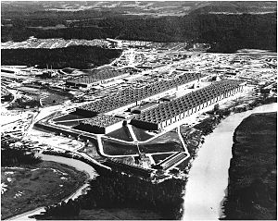
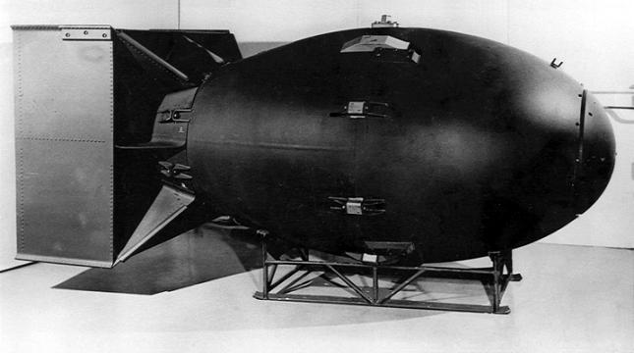
There were over 300 military and civilian women involved in the Manhattan Project, the secret program to create the atomic bomb.
-Women with advanced technical training served in important research jobs.
-WACs and wives of the scientists usually handled many of the clerical and service jobs.
NATIONAL GRANGE OF THE ORDER OF PATRONS OF HUSBANDRY

Slide 19
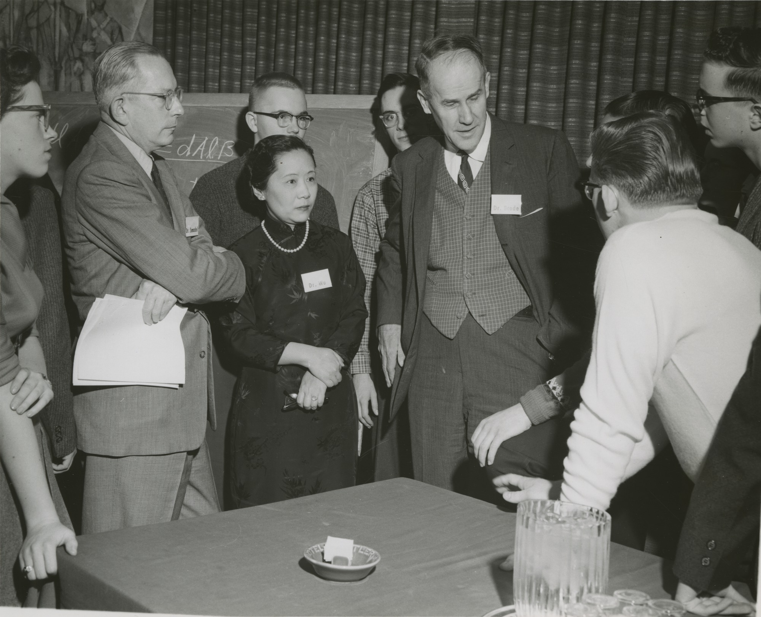
Dr. Chien-Shiung Wu was one of the only women scientists to work on the Manhattan Project at Columbia University, due to her work in nuclear fission.
She is considered the
“First Lady of Physics”
NATIONAL GRANGE OF THE ORDER OF PATRONS OF HUSBANDRY

Slide 20
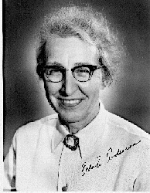
Elda “Andy” Anderson, a Ph.D. from the University of Wisconsin, was also a major contributor to the development of the atomic bomb.
She prepared the first sample of the uranium used for experiments in Los Alamos.
NATIONAL GRANGE OF THE ORDER OF PATRONS OF HUSBANDRY

Slide 21
Non-military Jobs for Women
NATIONAL GRANGE OF THE ORDER OF PATRONS OF HUSBANDRY

Slide 22
19
MILLION WOMEN WORKED IN THE FOLLOWING
AREAS DURING WWII:
MANUFACTURING
AIRCRAFT FACTORIES
MUNITIONS
THE ELECTRONIC INDUSTRY
TELEPHONE
OPERATORS
FARMING
SHIPYARDS
NATIONAL GRANGE OF THE ORDER OF PATRONS OF HUSBANDRY

Slide 23
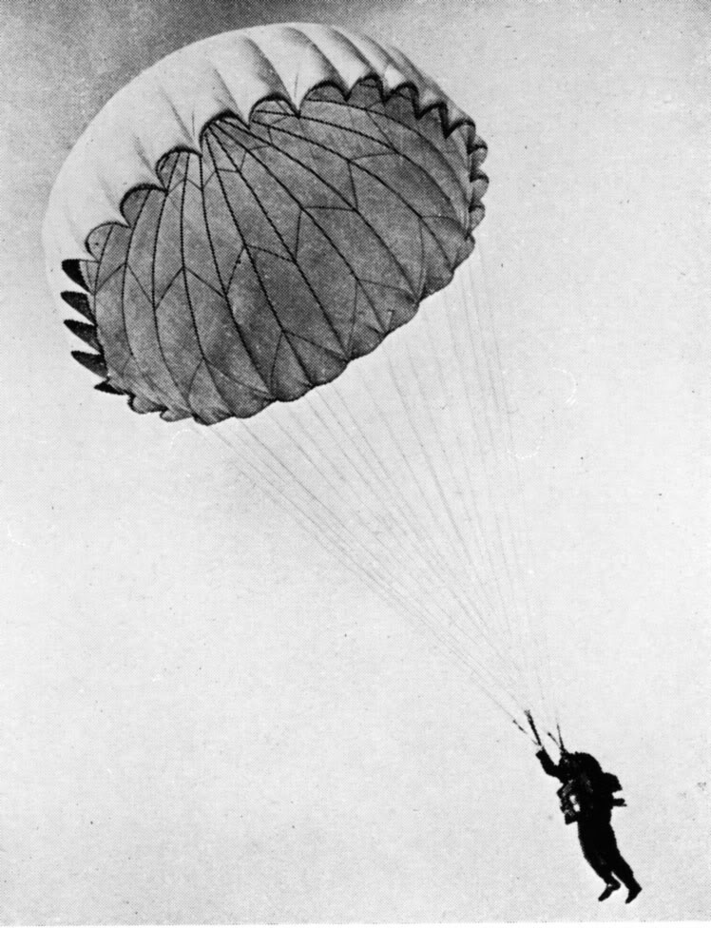
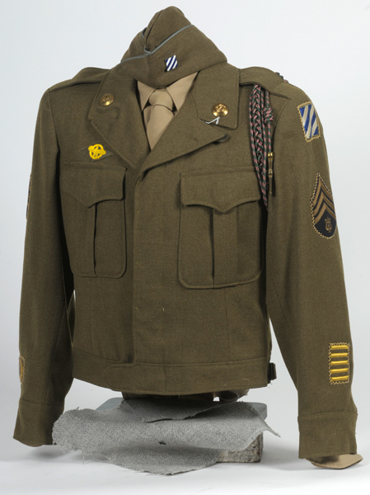
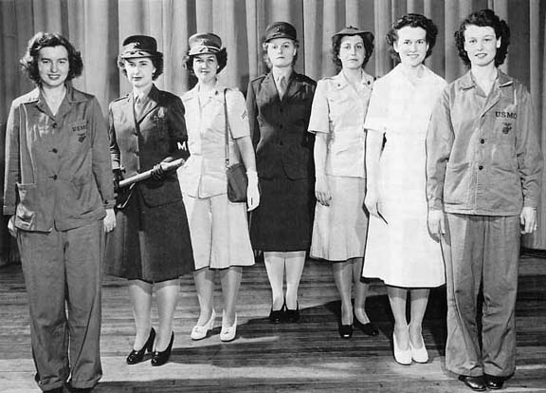
MANUFACTURING
Women manufactured such things as:
Parachutes
Uniforms
Clothing
NATIONAL GRANGE OF THE ORDER OF PATRONS OF HUSBANDRY

Slide 24
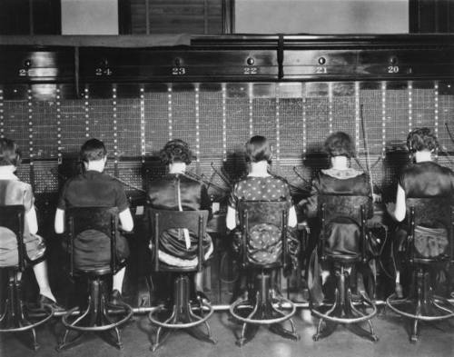
Telephone operators and other jobs in the electronics industry were handled by unmarried women because they were thought to have better manual dexterity and greater tolerance for repetitive assignments than men.
NATIONAL GRANGE OF THE ORDER OF PATRONS OF HUSBANDRY

Slide 25
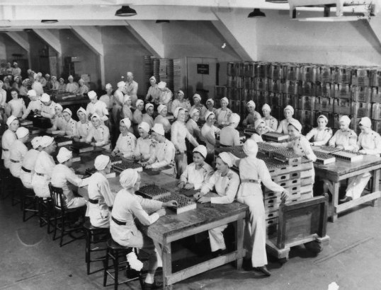
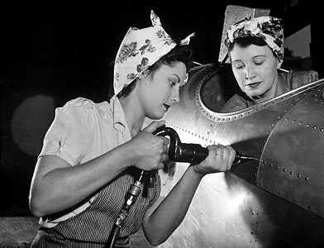
Munitions
Women worked in munitions plants and aircraft factories during the War due to increase of more than 40% of their normal wages.
Generally speaking working-class wives, widows, divorcees, and students primarily worked in this area.
Munitions plants were located in unpopulated areas because of chances there could be an accidental explosion and fire. Due to this, many women had to be recruited and moved to these rural areas that often faced shortages of housing and food services.
Aircraft Factory
NATIONAL GRANGE OF THE ORDER OF PATRONS OF HUSBANDRY

Slide 26
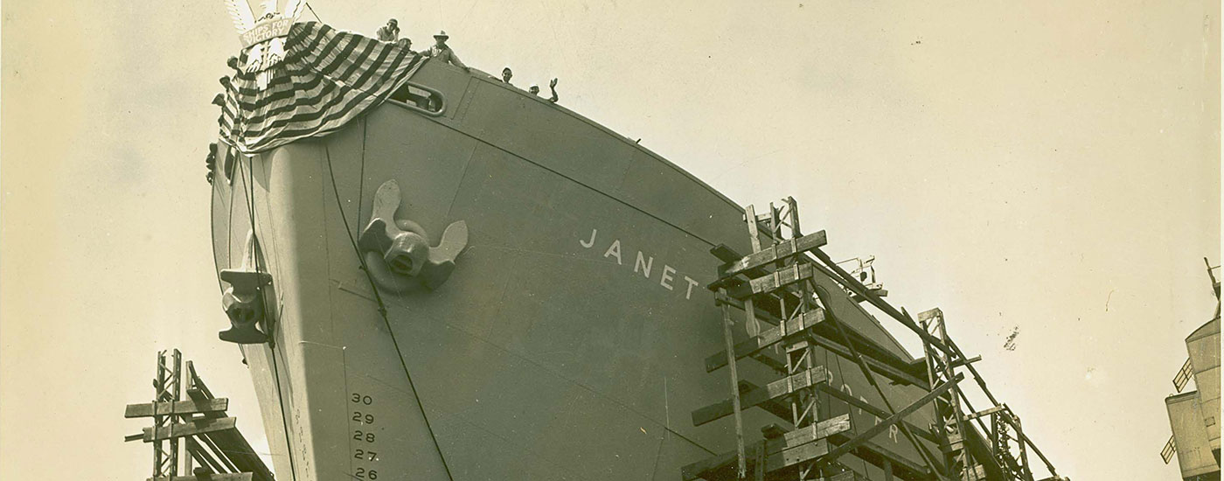
Women also worked in shipyards, factories, production and farming (Women’s Land Army). For Example, at Todd Shipyards, women numbered over 100,000 and work in 10 port cities.
Because of women workers, factories saw total production double between 1939 and 1945. Military production totaled: 300,000 aircraft, 12,000 ships, 86,000 tanks and 64,000 landing craft; also millions of artillery pieces and small weapons.
At this time, women worked 6 days a week, numerous days of overtime and were off only a handful of holidays to allow the assembly lines to work around the clock.
Women were critical in keeping the rails and trains maintained to make sure critical war material and troops flowed. Also, women were hired to be transit workers, taxi drivers, professional and technical workers in radio and journalism.
NATIONAL GRANGE OF THE ORDER OF PATRONS OF HUSBANDRY

Slide 27
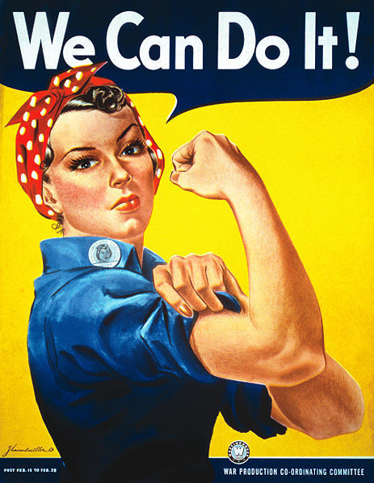
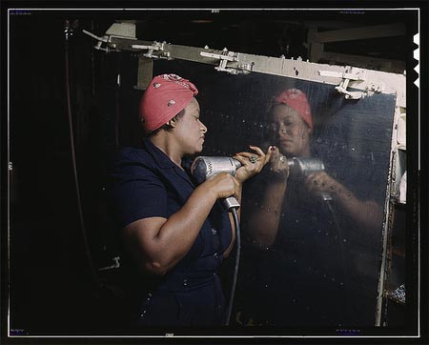
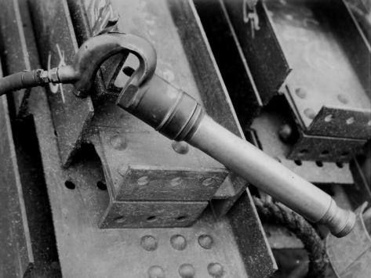
Rose Will Monroe, a Kentucky teenager, became a riveter, reflecting the part of “Rosie the Riveter” in a government film promoting war bonds. Monroe, widowed and the mother of two, moved to Michigan to take a riveter job at the Willow Run aircraft factory.
NATIONAL GRANGE OF THE ORDER OF PATRONS OF HUSBANDRY

Slide 28
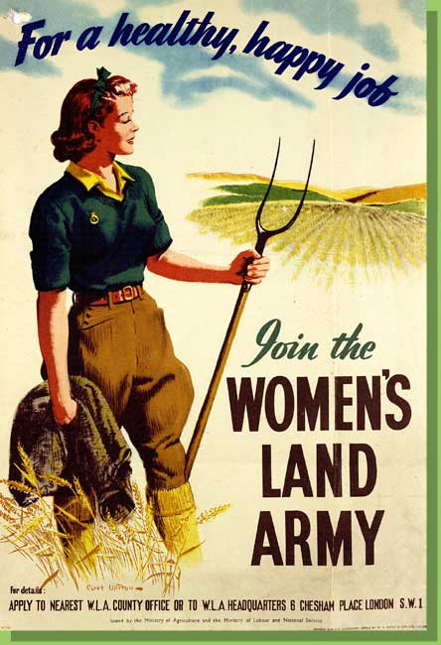
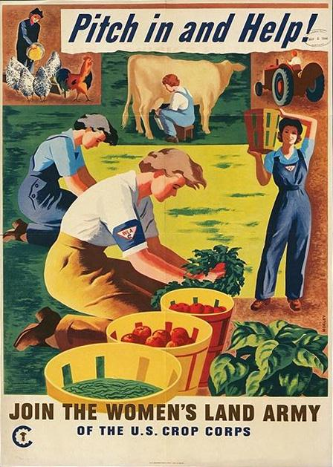
The Women’s Land Army began during the First World War and returned for this war as well. The women were volunteers who worked on farms and picked crops. Over a million women and girls participated, even though there wasn’t much money and they had to pay for their own room and board.
Agricultural schools trained these women for farm work that included sheep shearing, tractor driving and other equipment operations.
NATIONAL GRANGE OF THE ORDER OF PATRONS OF HUSBANDRY

Slide 29
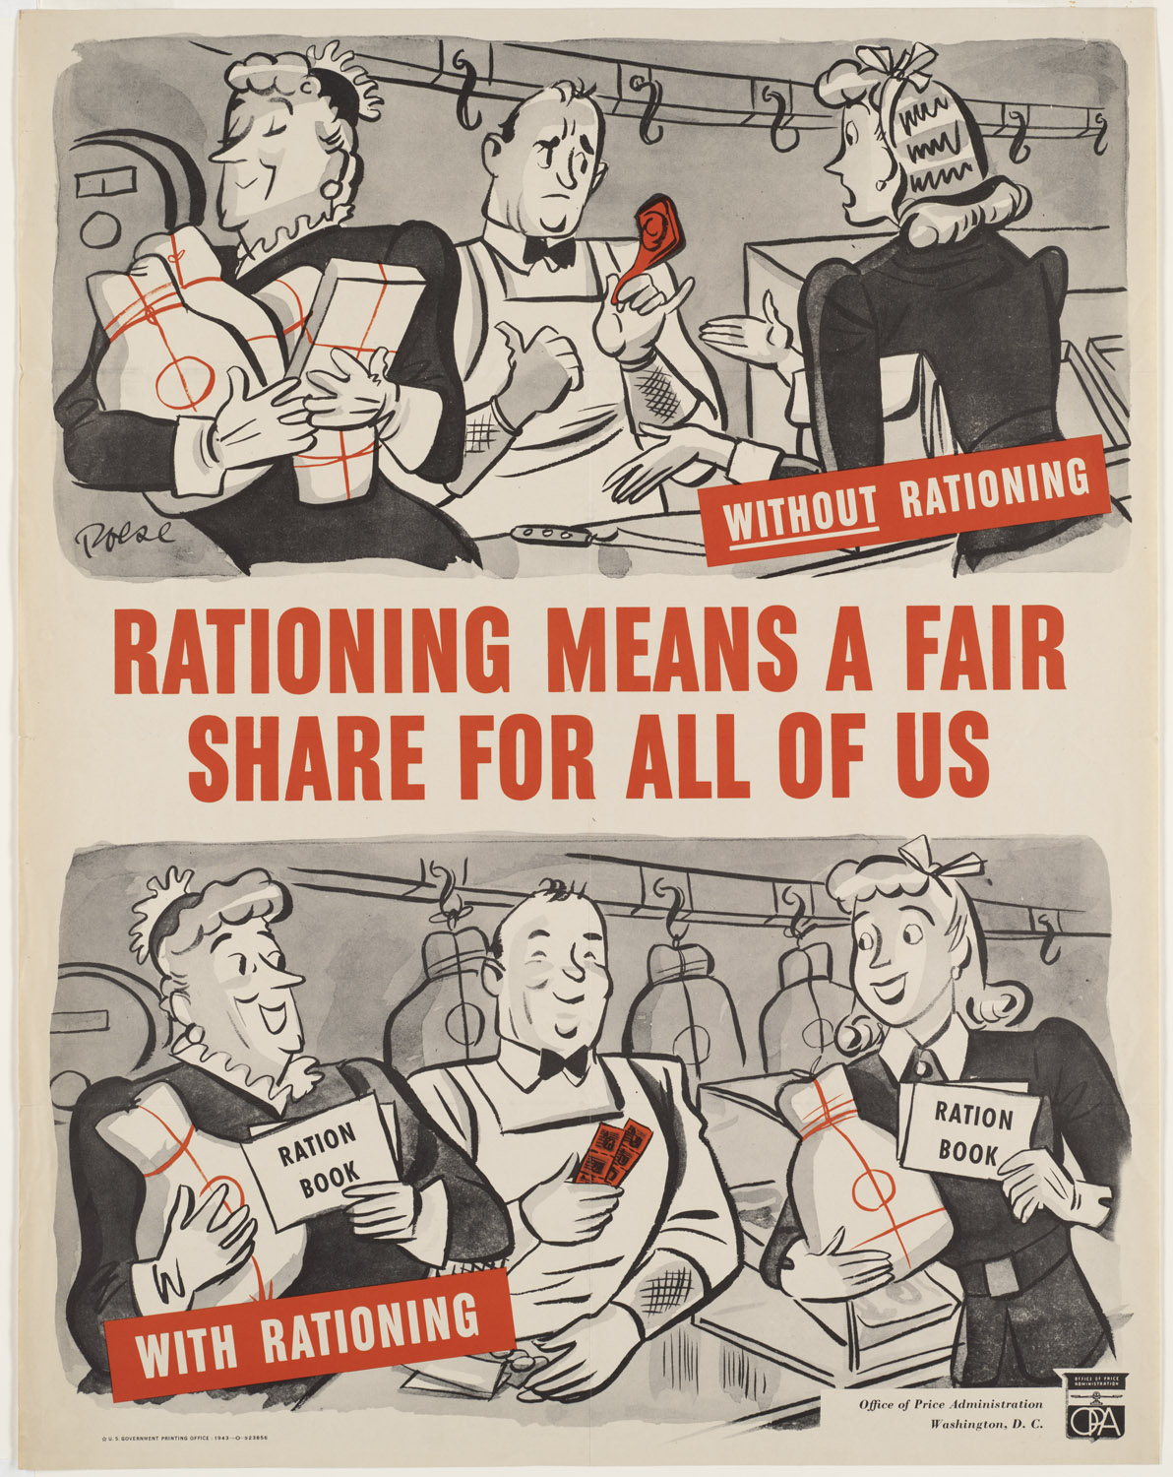
Civil Defense, rationing, recreation and fundraising were all areas that many women were involved in during the War, especially married women.
NATIONAL GRANGE OF THE ORDER OF PATRONS OF HUSBANDRY

Slide 30
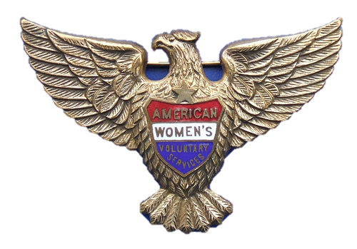
American Women’s Voluntary Services
The American Women’s Voluntary Services was the largest organization for women during the War. They were trained to drive ambulances, fight fires and provide emergency medical aid.
Women were responsible for driving the sick and wounded, and the out of town military and government personnel, at their own expense, as well as deliver supplies.
NATIONAL GRANGE OF THE ORDER OF PATRONS OF HUSBANDRY

Slide 31
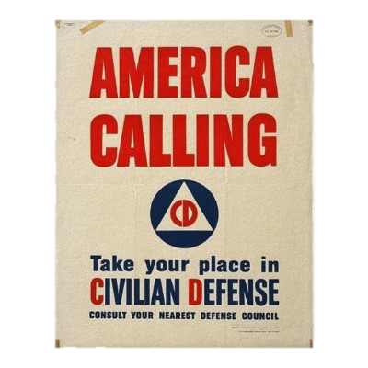
The Office of Civil Defense and its local councils, coordinated many of the local civilian defense initiatives. Women made up the primary number of civil defense volunteers.
Coastal communities used their local civil defense committees to scan for enemy aircraft and vessels, to enforce blackouts and to serve as air raid wardens in case of attack.
NATIONAL GRANGE OF THE ORDER OF PATRONS OF HUSBANDRY

Slide 32
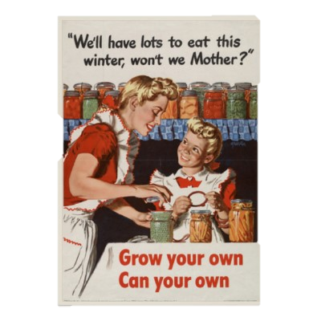
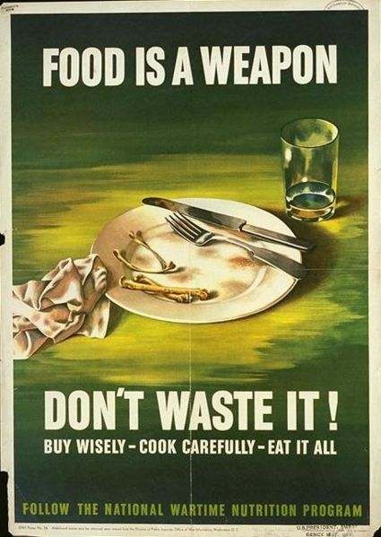
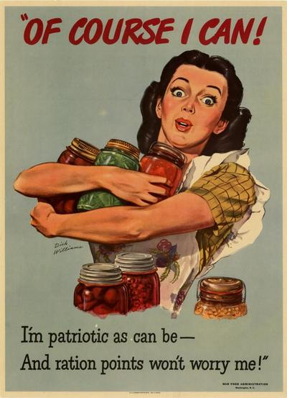
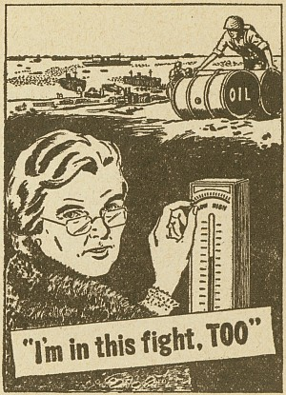
During the war, America was forced to initiate rationing programs not just on food but metal, rubber and consumer goods as well.
Women supplemented their food rationing with Victory gardens and canning their own vegetables. In 1944, 21 million families planted 7 million acres, which produced 8 million tons of vegetables.
NATIONAL GRANGE OF THE ORDER OF PATRONS OF HUSBANDRY

Slide 33
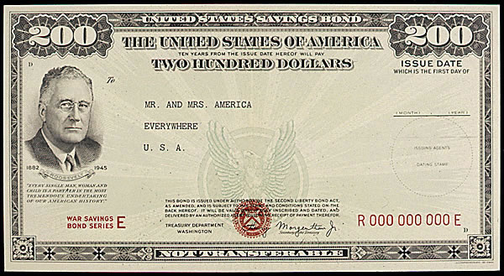
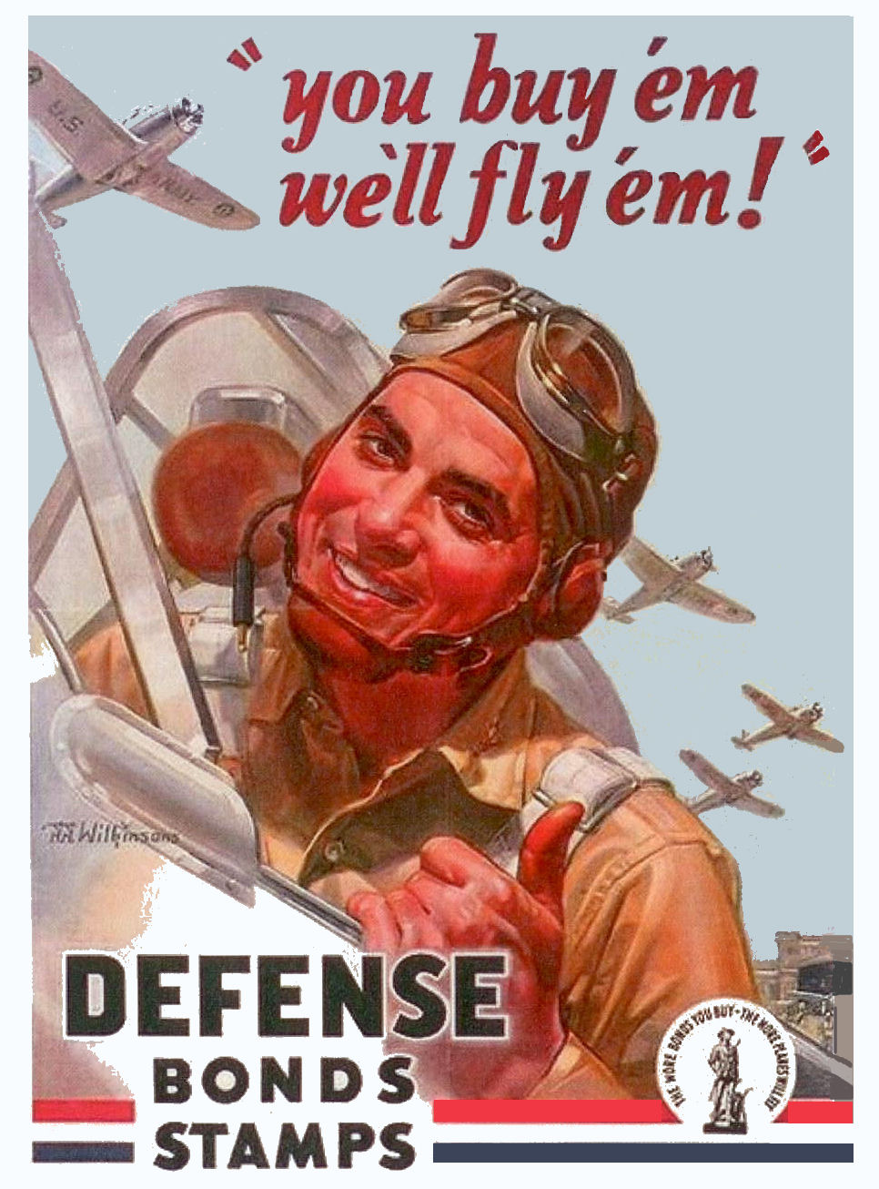
Women played a vital role in promoting the sale of war bonds to fund defense production.
One campaign alone funded 431 planes.
NATIONAL GRANGE OF THE ORDER OF PATRONS OF HUSBANDRY

Slide 34
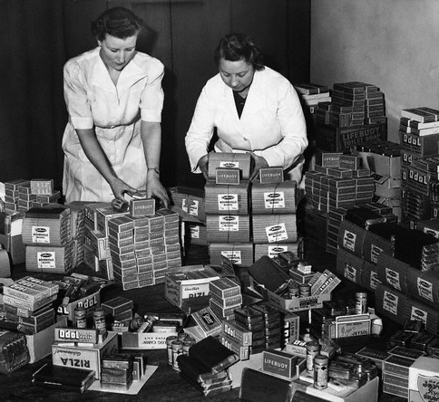
Millions of women knitted items of clothing and put together packages of food and personal hygiene items for troops overseas. Women who were not working handled childcare for the women who did.
NATIONAL GRANGE OF THE ORDER OF PATRONS OF HUSBANDRY

Slide 35
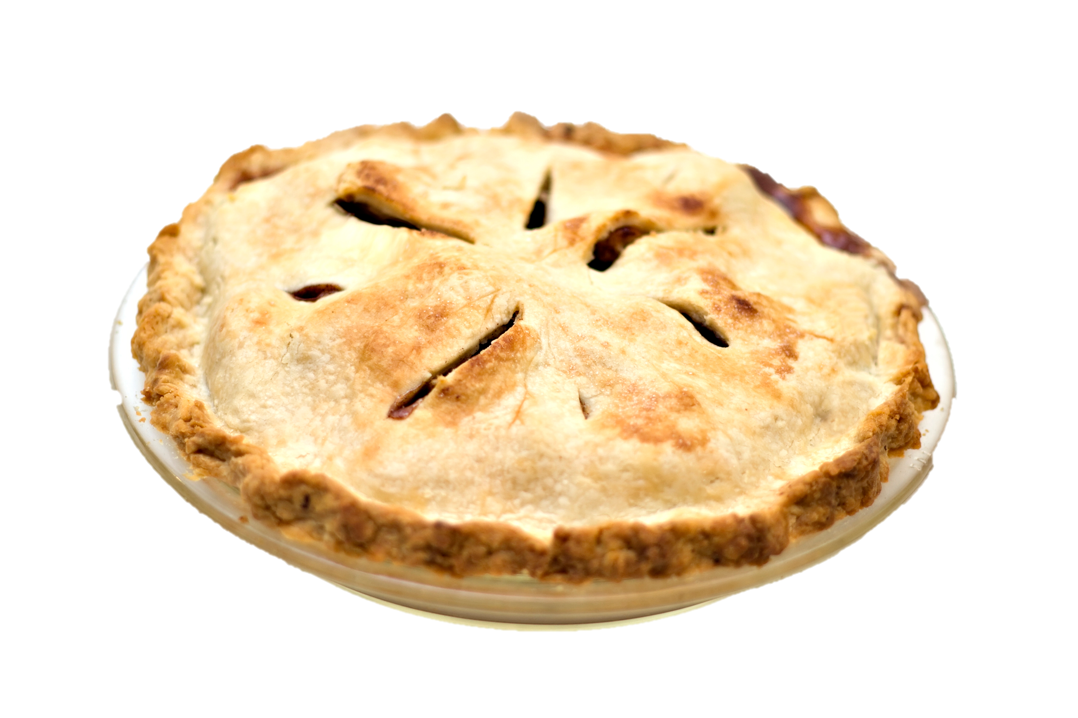
Women had a hard time overcoming the opposition to put women in “men’s” jobs. They overcame this through various campaigns by reminding people that production work called for domestic skills.
One example, if a woman could make a pie, then she could work an assembly line. Public relations and public perception played a vital role in including women in the war effort.
NATIONAL GRANGE OF THE ORDER OF PATRONS OF HUSBANDRY

Slide 36
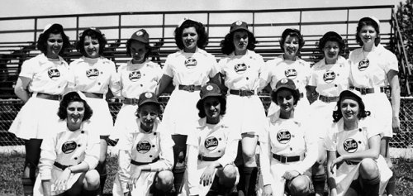
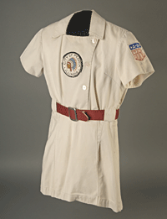
The women’s baseball league, All-American Girls Baseball League, was organized during WWII. The team was all white and required strict obedience in dress, curfews, and hairstyles. This league
continued until 1954.
Many of the industrial factories allowed softball leagues.
NATIONAL GRANGE OF THE ORDER OF PATRONS OF HUSBANDRY

Slide 37
Women after the end of the War
NATIONAL GRANGE OF THE ORDER OF PATRONS OF HUSBANDRY

Slide 38
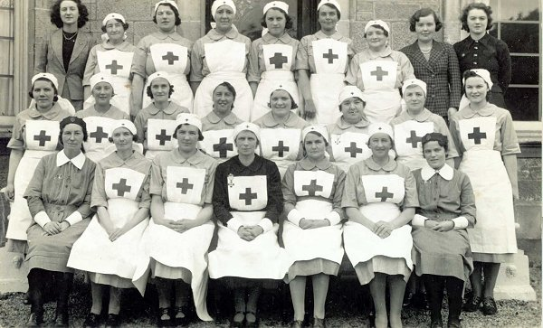
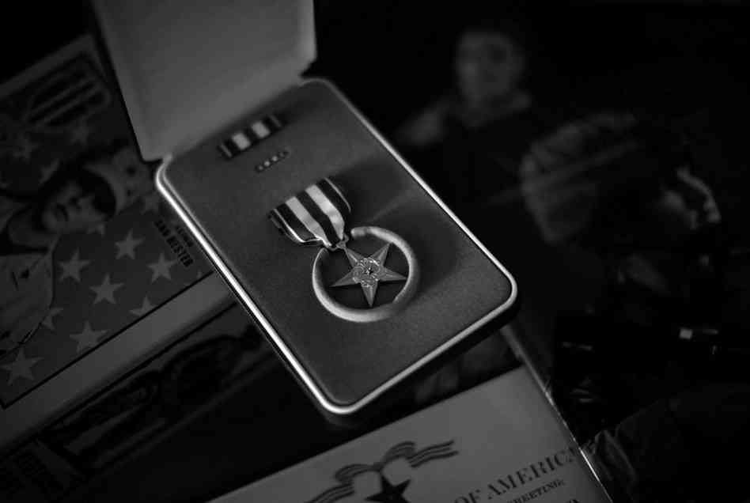
More than 1600 nurses were decorated for bravery under fire and meritorious service.
564 WACs in the Pacific Theater won combat decorations.
NATIONAL GRANGE OF THE ORDER OF PATRONS OF HUSBANDRY

Slide 39
On the other side of that show of gratitude, women veterans (only women who were listed as members of the armed services) saw roadblock after roadblock in trying to take part in benefit programs set up for veterans, like the G.I. Bill, medical care and disability programs.
Many women lost their jobs to men coming back home, but it did become acceptable for women to work outside the home, even for married women.
NATIONAL GRANGE OF THE ORDER OF PATRONS OF HUSBANDRY

Slide 40
37,000
210,000
American civilian women killed during WWII
American civilian women permanently disabled during WWII
NATIONAL GRANGE OF THE ORDER OF PATRONS OF HUSBANDRY

Slide 41
Grange Women during WWII
NATIONAL GRANGE OF THE ORDER OF PATRONS OF HUSBANDRY

Slide 42
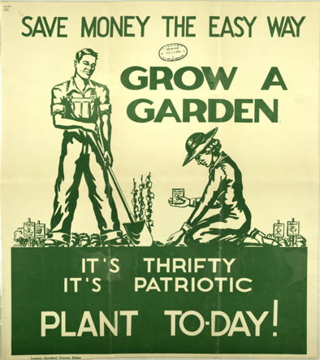
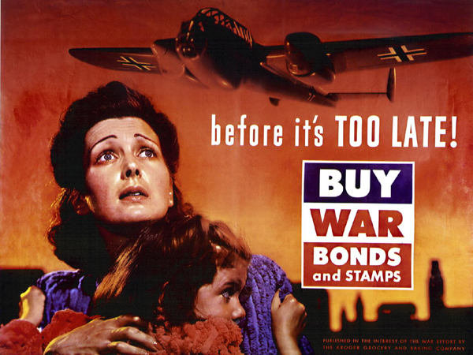
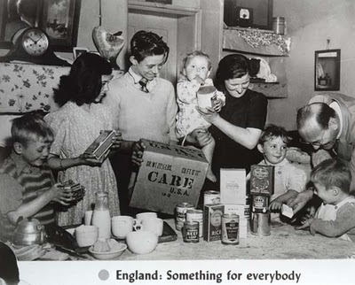
GRANGES helped by:
Home Gardens
Buying War Bonds
Sending gifts to Grangers in Military
NATIONAL GRANGE OF THE ORDER OF PATRONS OF HUSBANDRY

Slide 43
-Who were the women in your Grange and community?
-What did these women do?
Take time to thank the women in your Grange and community for their efforts during World War II
NATIONAL GRANGE OF THE ORDER OF PATRONS OF HUSBANDRY

Slide 44
Sources:
Women of the Grange by Donald B. Marti
Flying for her Country by Amy Goodpaster Strebe
www.whenourmotherswenttowar.com
http://www.history.army.mil/brochures/WAC/WAC.HTM
http://www.nationalww2museum.org/learn/education/for-students/ww2-history/at-a-glance/women-in-ww2.html
NATIONAL GRANGE OF THE ORDER OF PATRONS OF HUSBANDRY

Slide 45
Additional Resources:
On the Farm Front: The Women’s Land Army in WWII by Stephanie A. Carpenter
Her War: American Women in WWII by Eleanor Lang & Katherine Dobie
Our Mother’s War: American Women at Home & at the Front during WWII by Emily Yellin
American Experience: Fly Girls DVD & CD Rom (Documentary)
We Band of Angels: The Untold Story of American Nurses Trapped on Battaan by the Japanese by Elizabeth Norman
A WASP Among Eagles: A Woman Military Test Pilot in WWII by Ann Carl
Rosie the Riveter: Women working on the Home Front in WWII by Penny Coleman (Young Adult Book)
Photo Book: Making WAVES: Navy Women of WWII by Evan Bachner
One Woman’s Army: A Black officer remembers the WAC by Charity Adams Earley
And If I Perish: Frontline US Army Nurses in WWII by Evelyn Monahan & Rosemary Neidel-Greenlee
When Diamonds Were a Girl’s Best Friend by Janis Taylor (Documentary 1992)
NATIONAL GRANGE OF THE ORDER OF PATRONS OF HUSBANDRY

